Slide 1
Welcome
Cyclistic Member vs. Casual Bike Usage
By Michael Wong, Jr. Data Analyst
5.4.22

Slide 2
Scenario
I am a junior data analyst working in the marketing analyst team at Cyclistic, a bike-share company in Chicago. The director of marketing believes the company’s future success depends on maximizing the number of annual memberships. My team wants to understand how casual riders and annual members use Cyclistic bikes differently. From these insights, my team will design a new marketing strategy to convert casual riders into annual members. But first, Cyclistic executives must approve my recommendations, so they must be backed up with compelling data insights and professional data visualizations.

Slide 3
Ask
Key Objectives
How do the usages of bikes differ between members and casual riders?
How can we market the membership to current casual riders?
How can we convert them into members?

Slide 4
Prepare
I downloaded the datasets from April 2021 through March 2022 here.
The data has been made available by Motivate International Inc. under this license.
I explored and assessed the datasets on Excel.
The data is filed by month.
Rider personal information is not included for privacy.
The dataset is reliable, original, comprehensive, current, and cited.

Slide 5
Process
I imported the data into SQL to clean more efficiently.
Removed any duplicate rides
Removed any rows with NULLs
Removed any rides less than 1 minute and over 24 hours in length
Removed any rides where the bikes were docked for multiple days
Removed any rides used for maintenance and data testing
View my SQL code here on GitHub.

Slide 6
Process cont.
I calculated the trip duration by subtracting the end time from the start time into a “ride_length” column.
“total_min” was then calculated and separated by minutes.
The day of the week, month, and year for each trip was populated into separate columns.
Bike usage was calculated by dividing trip duration by total sum of trip duration.
The data was summarized in Excel with Pivot Tables and imported into Tableau to create visualizations.

Slide 7
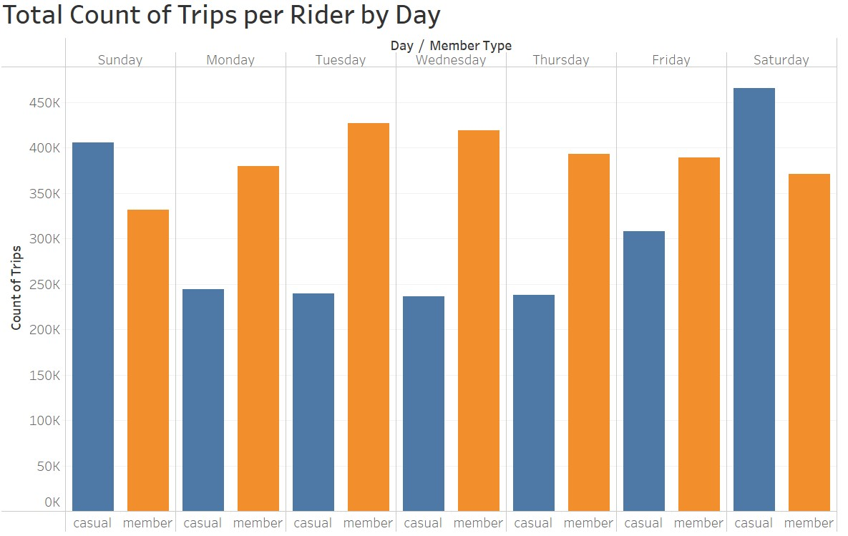
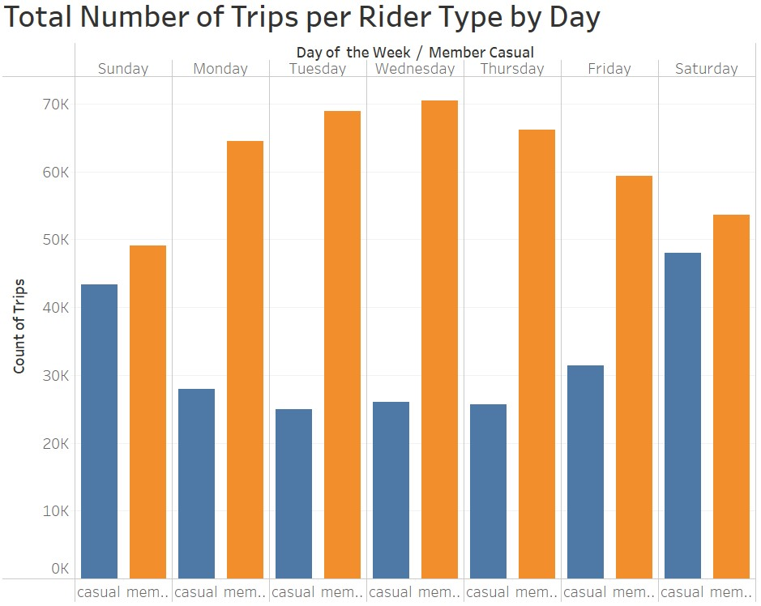
Analyze
Total Count of Trips
Members take almost twice as many rides as casual riders.
While, casual riders tend to take more trips on the weekend than on weekdays.

Slide 8
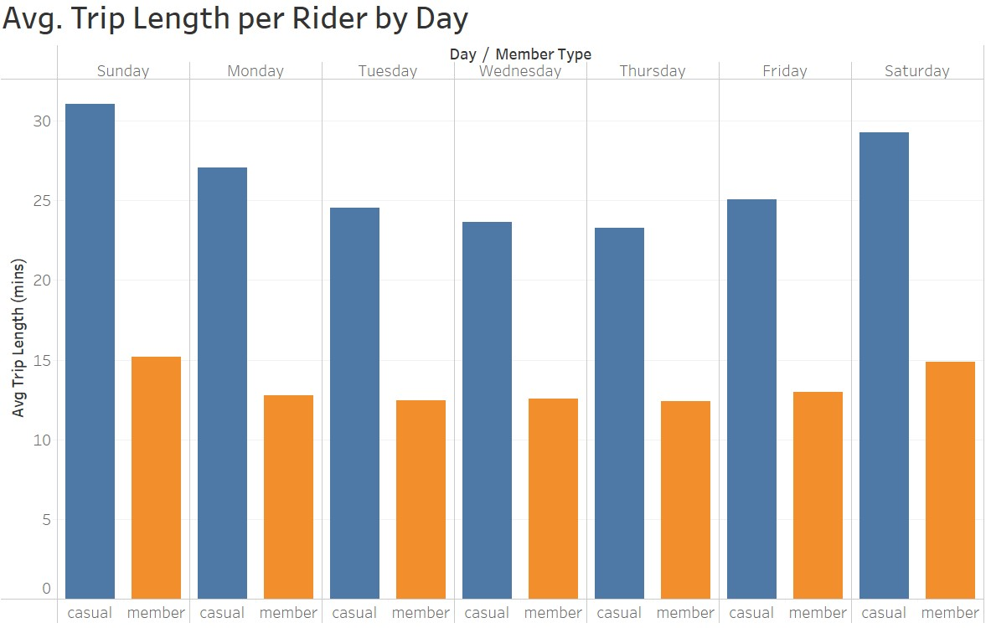
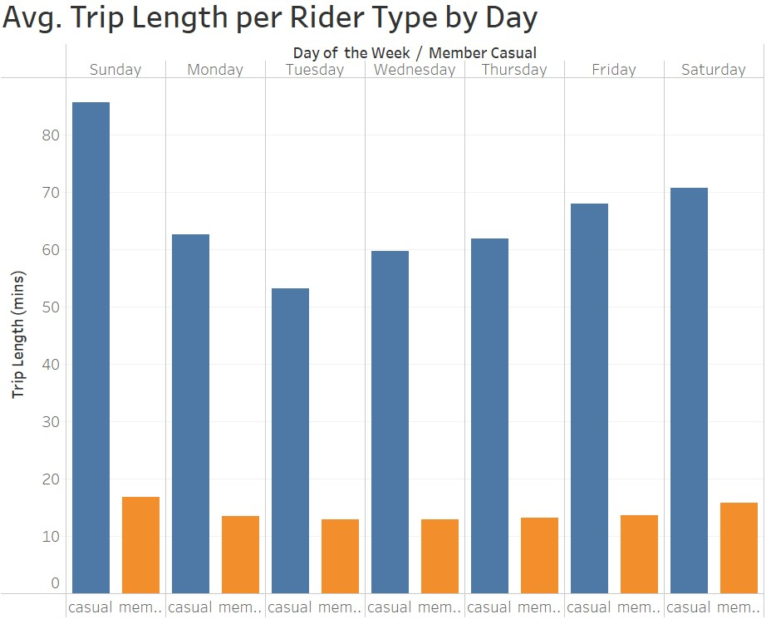
Analyze Cont.
Trip Length
Looking at the length of trips between members, we see that casual riders on average take longer rides than members do.
Members consistently average rides below 20 mins throughout the week.

Slide 9
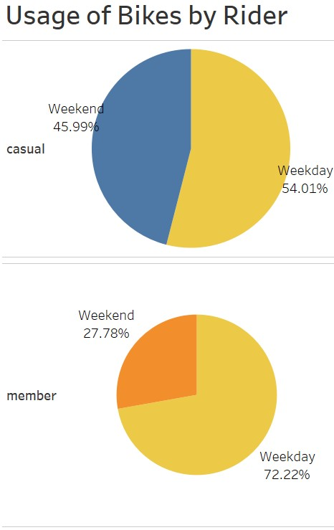
Analyze Cont.
Bike Usage
Casual riders use the bikes nearly 36% more than members do on the weekend
Members use the bikes much more on the weekdays.

Slide 10
Share
After analyzing the data, we can see members ride bikes more often on the weekdays than casual riders do.
Ridership spike on the weekends for casual riders, while membership trip durations stay consistent throughout the week.
This suggests that members tend to be commuters who use the bikes for work.
This can be supported looking at the number of rides taken throughout a day.

Slide 11
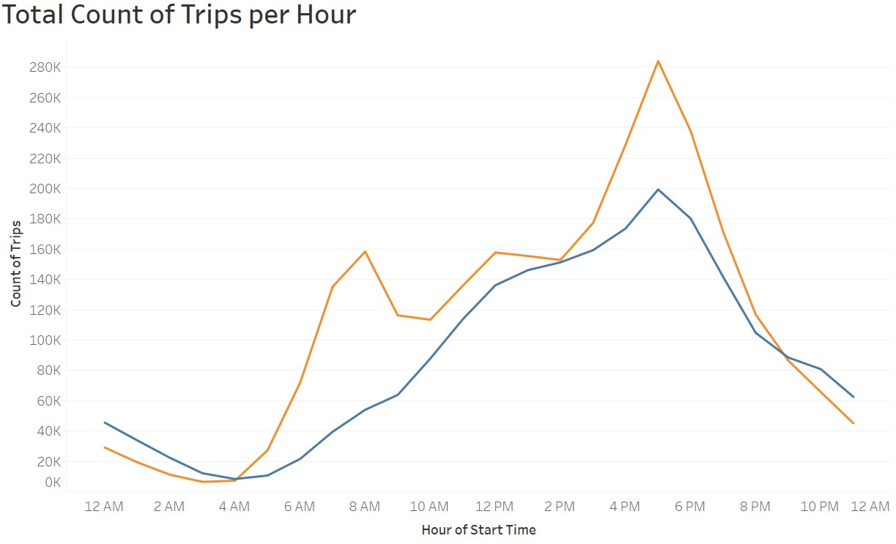

Share cont.
Members take bike rides more often than casual riders throughout the day.
We can see rides peak around 8am, 12pm, and 6pm suggesting peak rides occur during the morning, lunch, and evening rush hours.

Slide 12
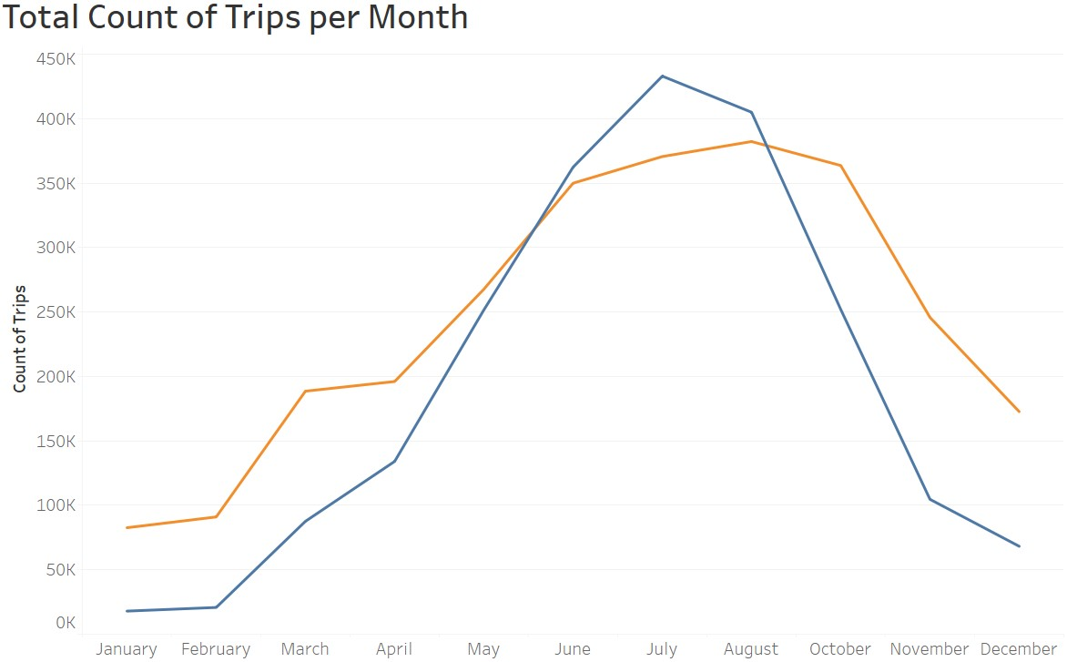
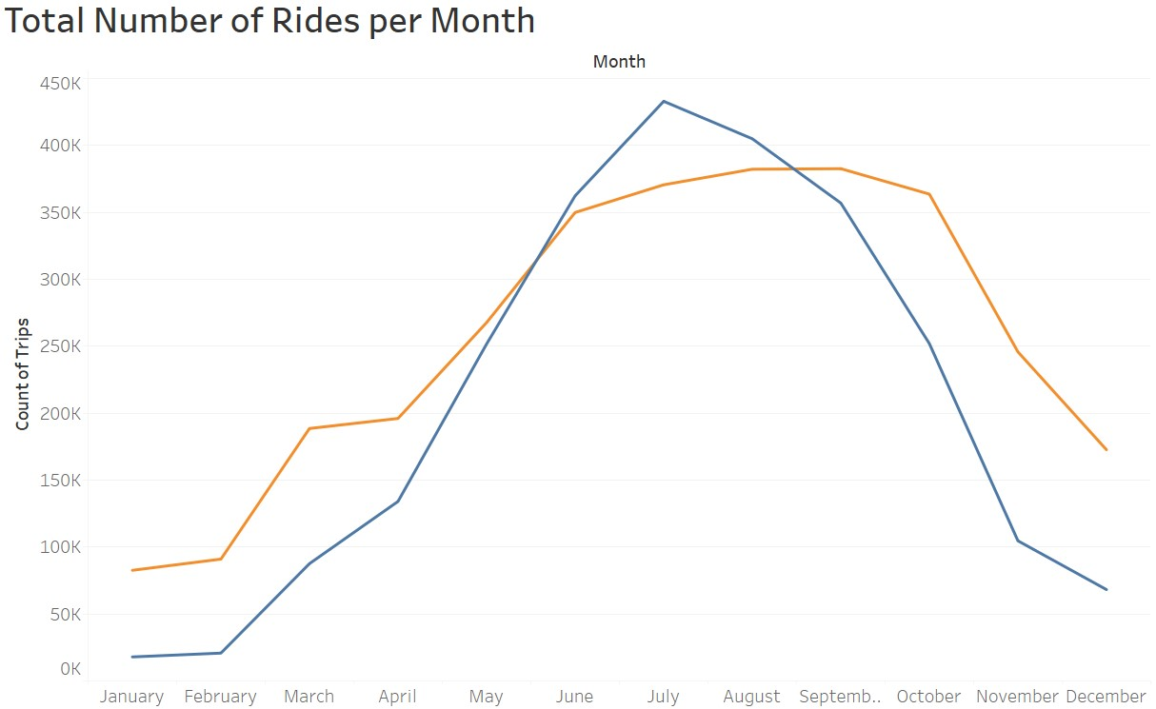
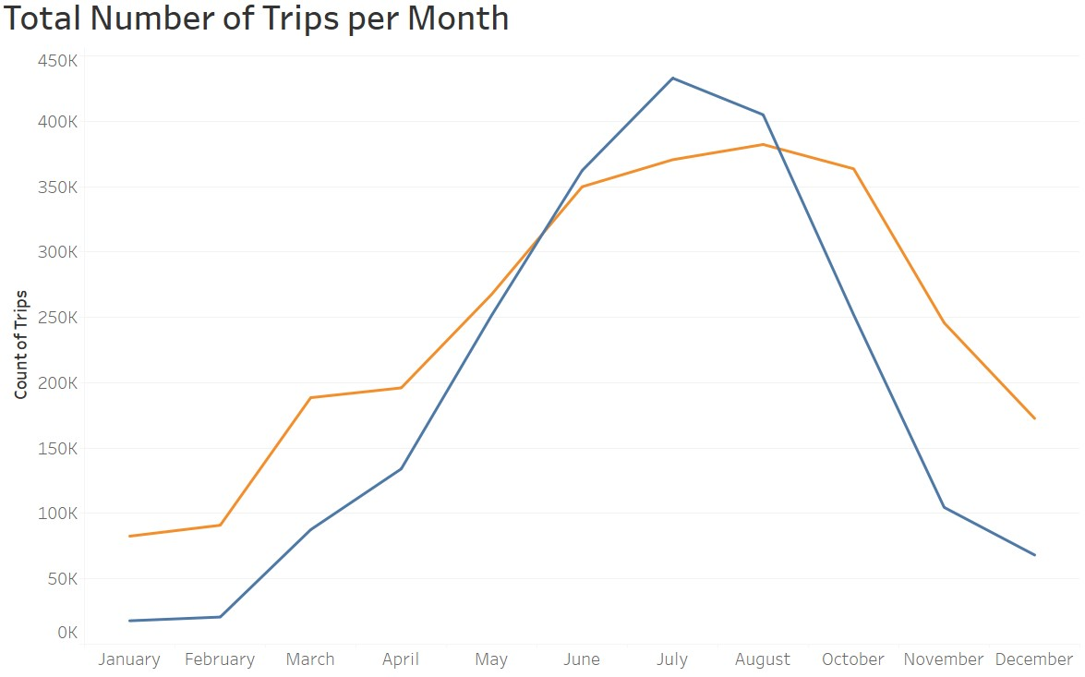
Share cont.
Looking at the year, casual riders exceed members in number of bike rides between mid May to mid August.
This could suggest an increase in locals on vacation and tourists visiting Chicago during those summer months.

Slide 13
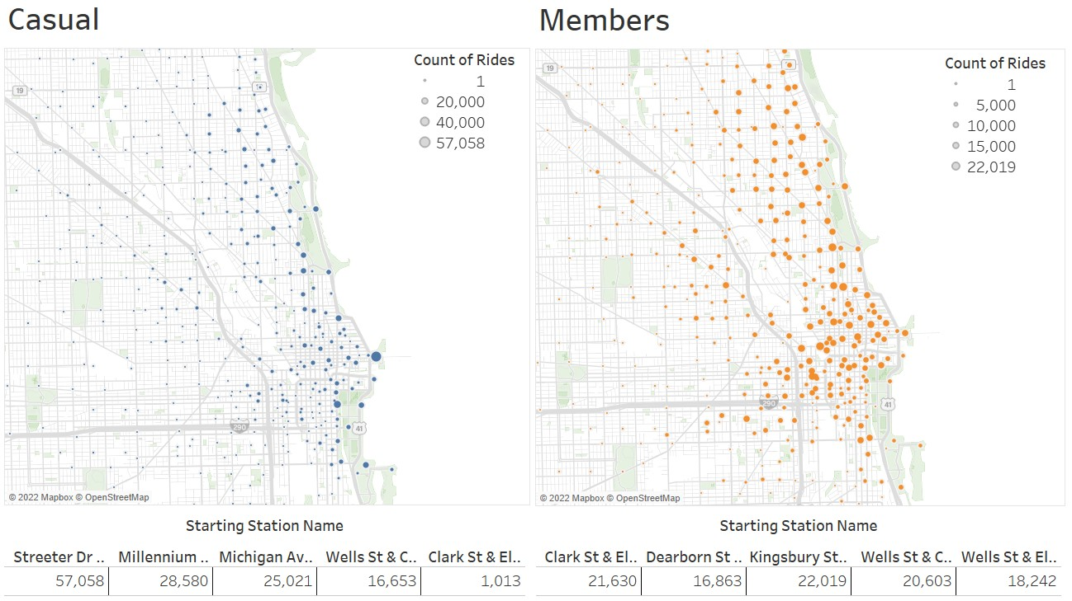
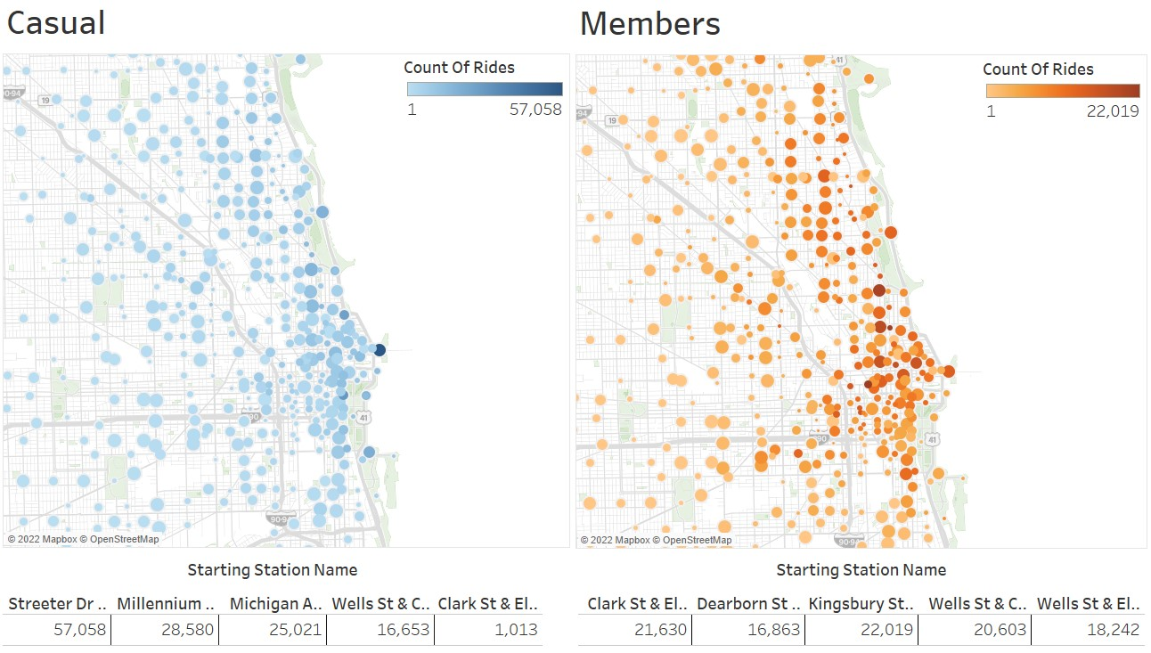
Share cont.
Additionally, casual riders tend to take more trips along the shoreline and around attractions suggesting that casual riders may also include tourists visiting the city.
On the other hand, members tend to ride further inland around downtown and residential areas.
Visualizations can be viewed on my storyboard here in Tableau.

Slide 14
Share cont.
Key Objectives (Revisited)
How do the usages of bikes differ between members and casual riders?
How can we market the membership to current casual riders?
How can we convert them into members?
Key Takeaways
Members are most likely commuters who ride bikes more often and consistently during weekdays than casual riders.
Casual riders may be a mixture of locals and tourists who ride bikes for longer periods of time and more often on the weekend.

Slide 15
ACT
Recommendations
Launch a marketing campaign highlighting the benefits of having an annual membership pass.
Rather than paying for each trip, emphasize the lower-cost per hour compared to not having an annual membership pass.
Provide priority access for members to secure a bike up to an hour in advance by making reservations through the app.

Slide 16
ACT cont.
Recommendations cont.
Create a weekend membership pass providing casual riders unlimited rides on the weekend. This could help persuade casual riders into purchasing annual memberships.
Launch tiered weekly and monthly passes to capture casual riders in the market who cannot commit to an annual pass.

Slide 17
THANK YOU
Michael Wong
mwong5940@gmail.com
LinkedIn GitHub Portfolio

